Slide 1
Event Share
CMPE 277 – Final Project
Submitted By:
Anjaneya Murthy
Bhuvan Teja Guddanti
Prashanth Mudhelli
Priyanka Ravikanti
Swarna Viswanathan

Slide 2
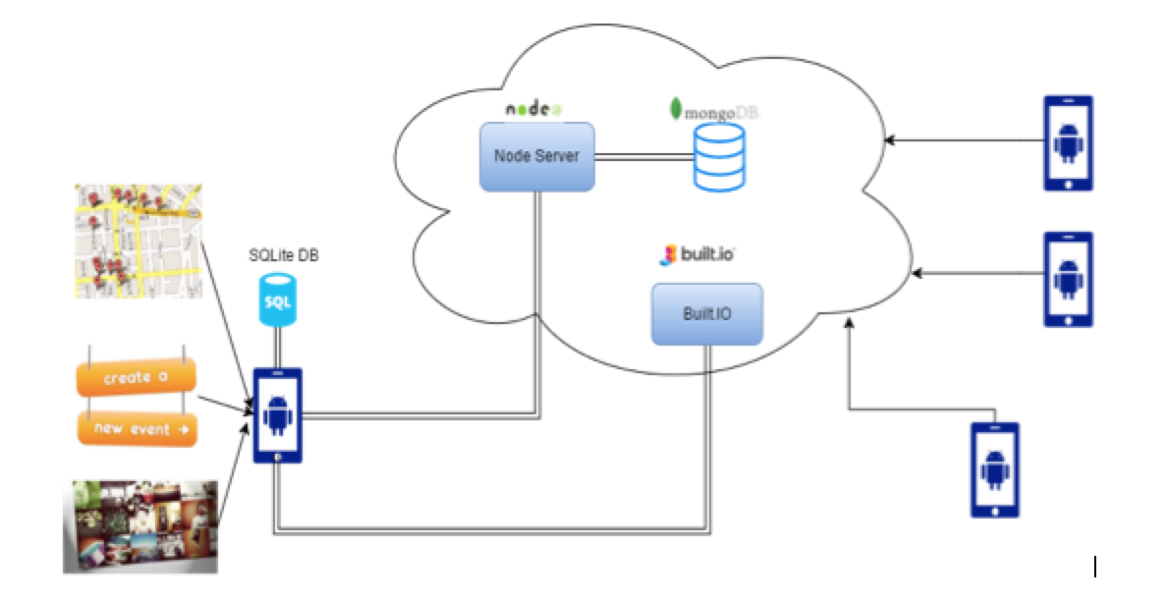
Architecture

Slide 3
Modules
Gmail Authentication for Login
Create Event
Send Invites
Approve Events
Reject Events
Share Location
Share Photos

Slide 4
Modules Contd.

Slide 5
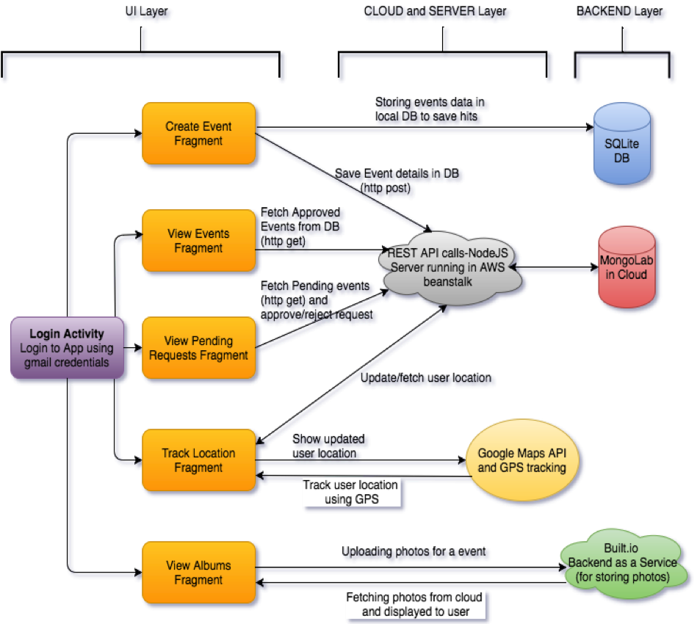
Work Flow Diagram

Slide 6
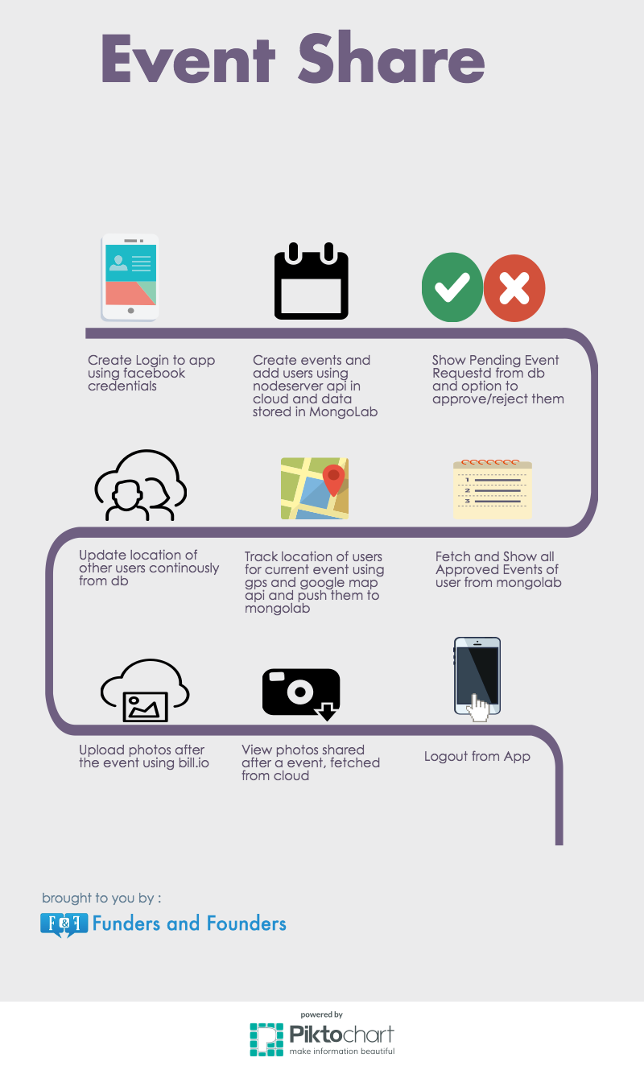
Sequence Flow Diagram (Infographic)

Slide 7
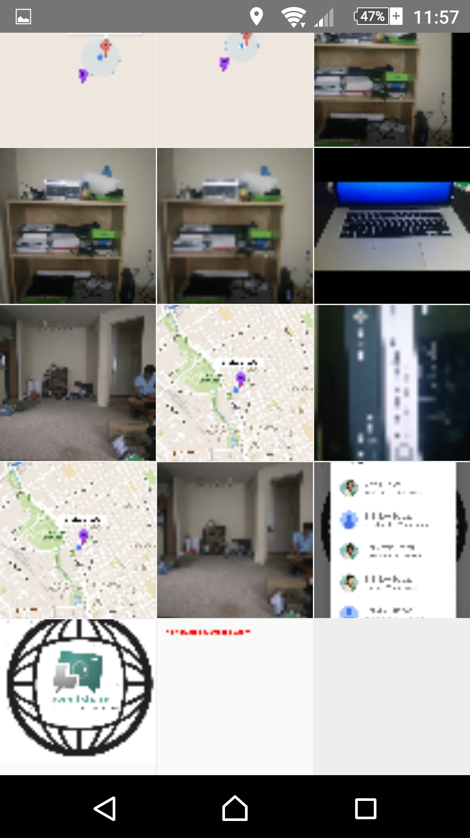
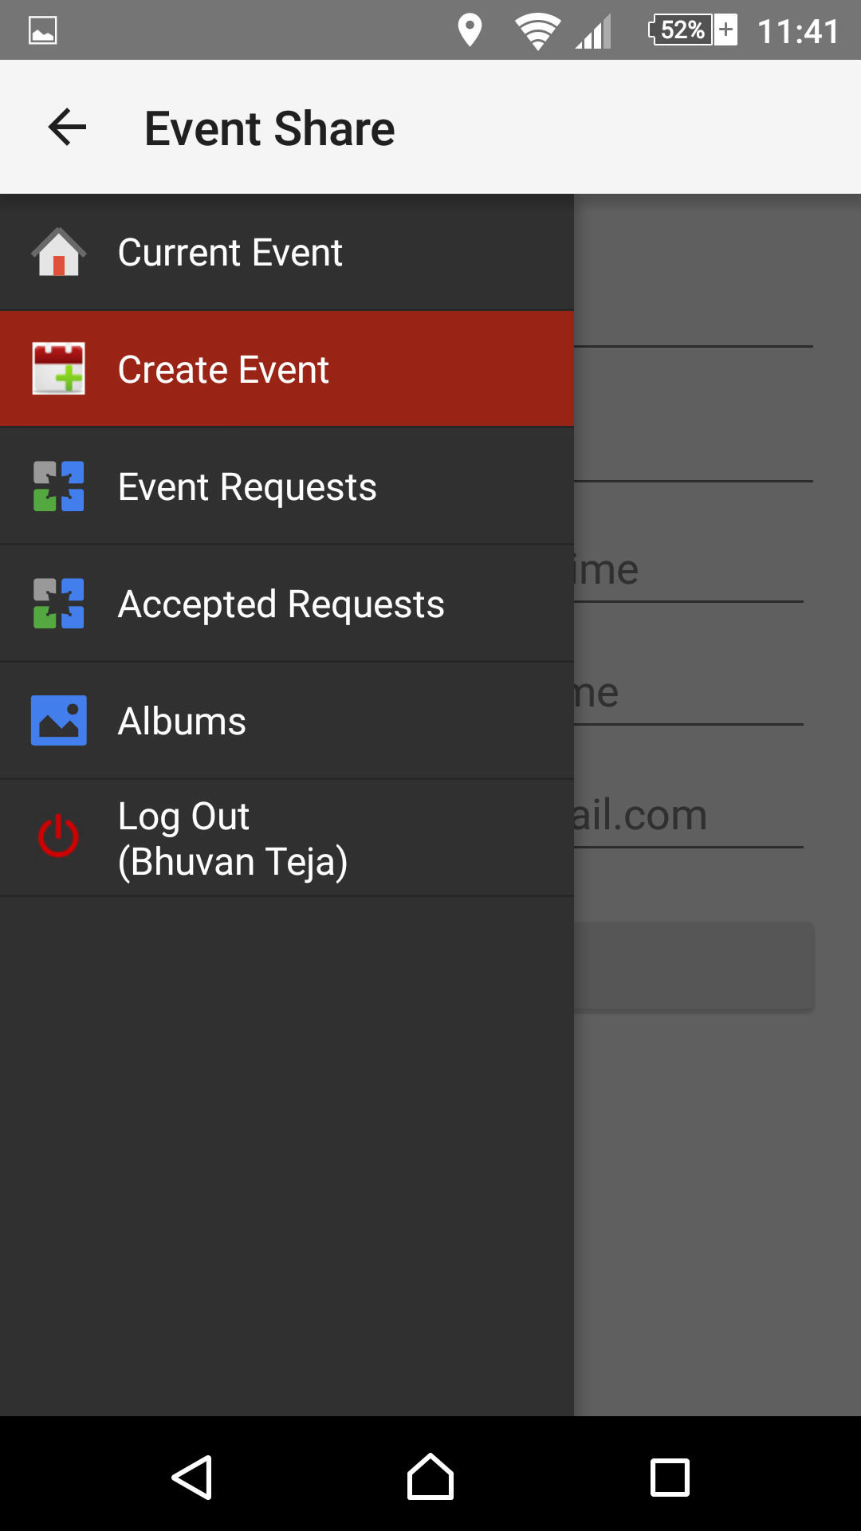
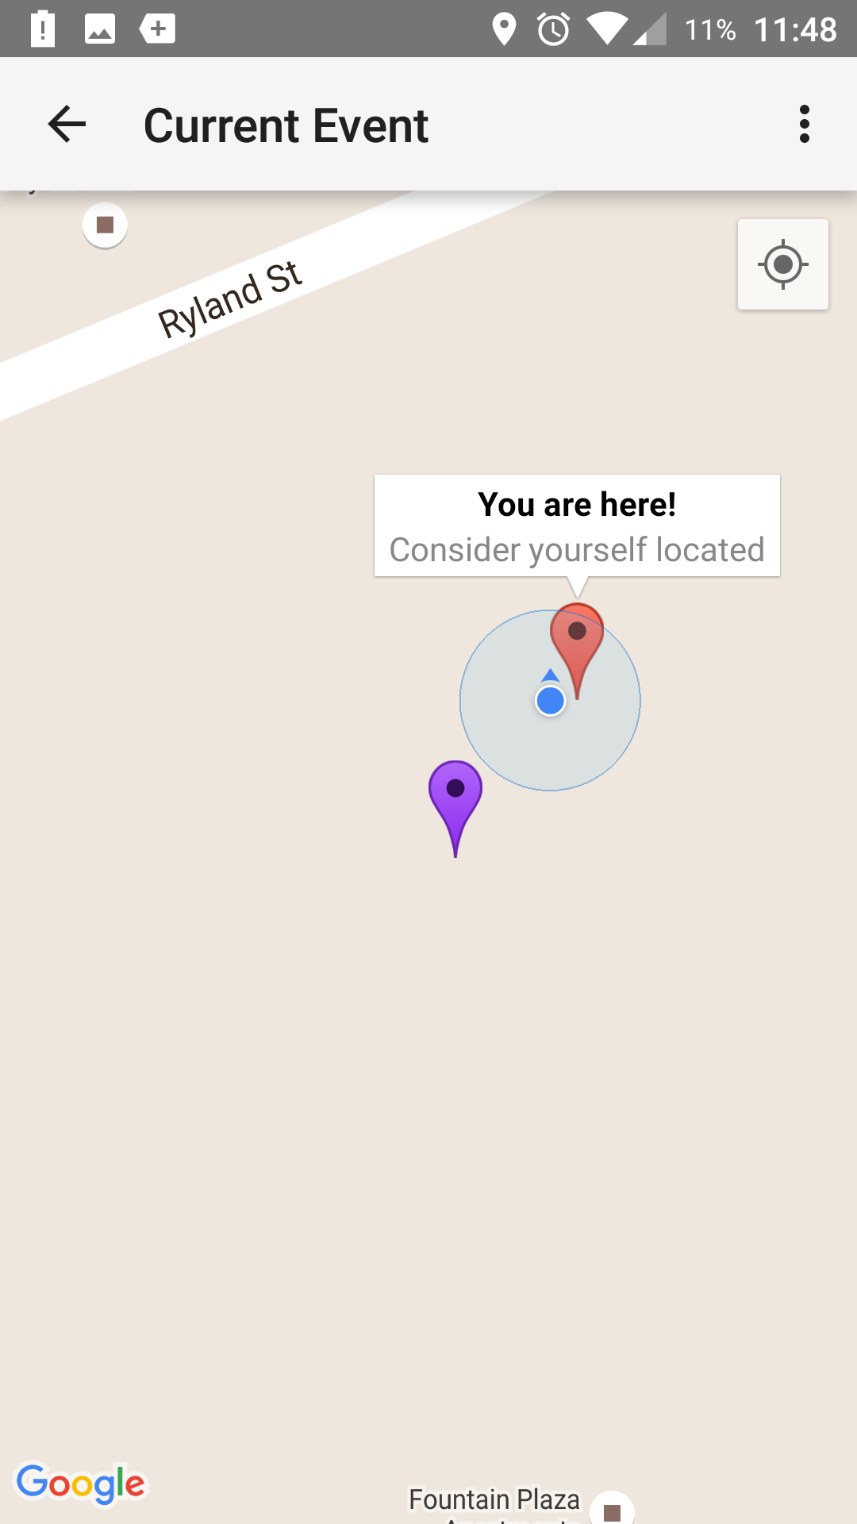
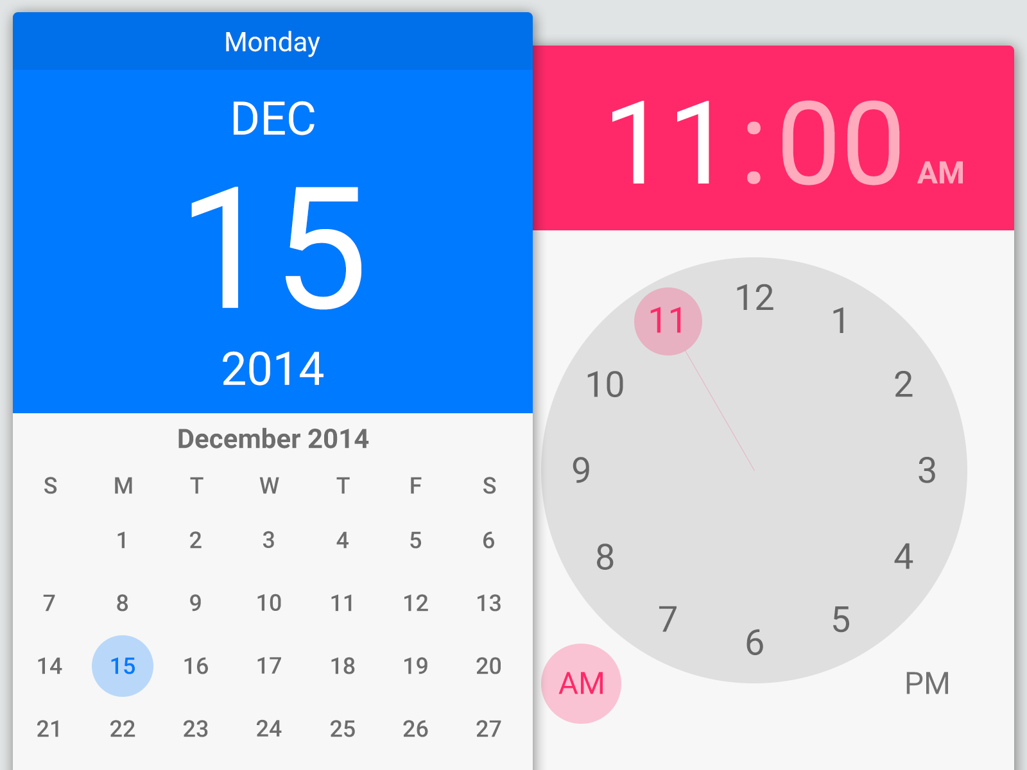
Material Design

Slide 8
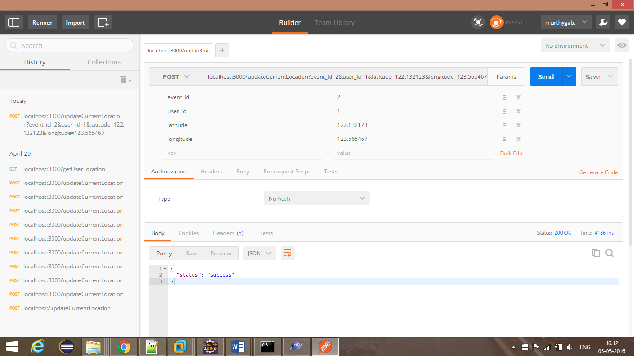
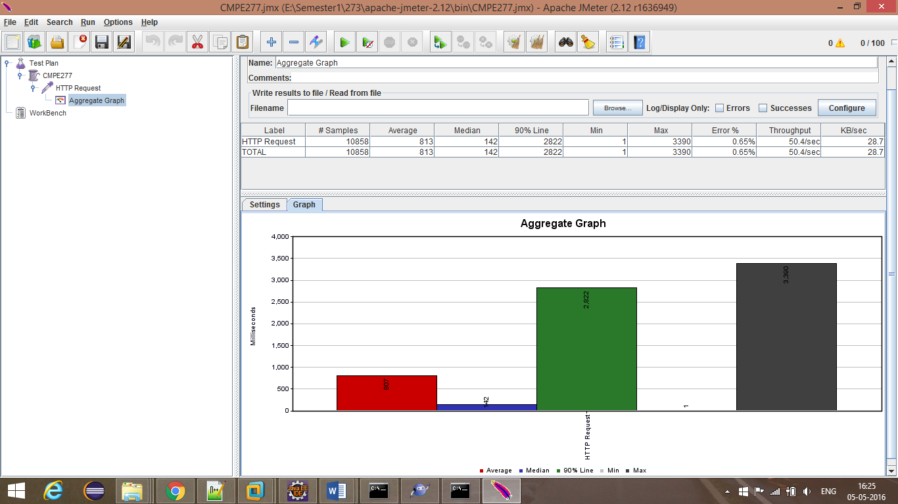
API, Load and Automation Testing

Slide 9














Technology Stack
loopj library

Slide 10
Thank you…!
Queries….??

